Slide 1
Theory and Practice of Bayesian Inference Using JASP
Johnny van Doorn

Slide 2

Practical Stuff
Did everyone manage to install JASP 0.95.4?
Reading
https://johnnydoorn.github.io/IntroductionBayesianInference/
Introduce myself
Slides → www.edu.nl/4qenh

Slide 3
Outline
Statistical Models
How do Models Learn from Data?
Comparing Statistical Models
Extending to other Tests
Some Practice

Slide 4

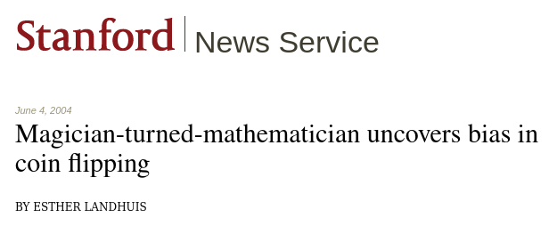
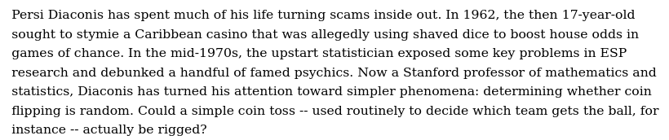
Source: https://news.stanford.edu/pr/2004/diaconis-69.html
https://osf.io/6a5hy/

Slide 5
What is Bayesian Inference?
What are the tools we need?

Slide 6
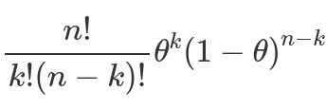
What are Statistical Models?
A statistical model is a combination of a general statistical model (e.g., the binomial model) and a statement about a parameter value that describe a certain phenomenon
The general binomial model describes a series of chance-based events with a binary outcome, and is governed by a single parameter θ
For instance, for flipping a coin:
A binomial model with θ = 0.5
What is the theoretical implication of this model?

Slide 7
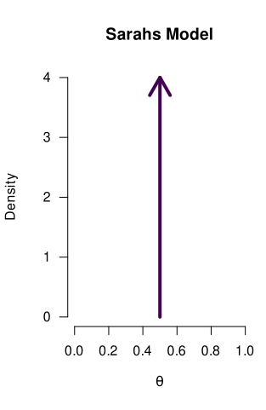
What are Statistical Models?
A binomial model with θ = 0.5
We can reflect a model’s statement by means of a probability distribution

Slide 8

What are Statistical Models?
A binomial model with θ = 0.8
We can reflect a model’s statement by means of a probability distribution

Slide 9
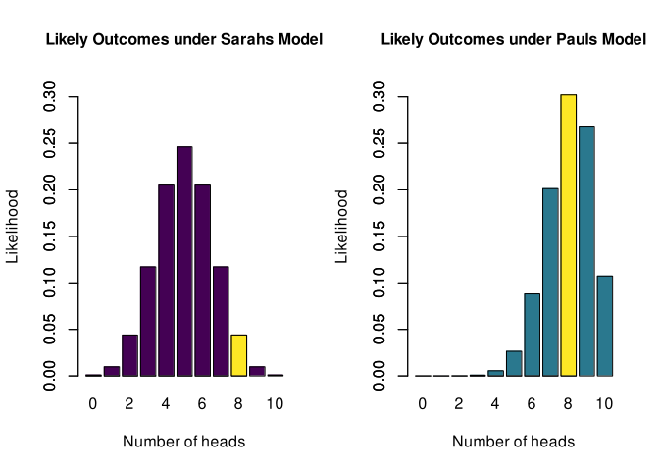
Statistical Models Make Predictions
Based on what these models claim about θ, certain outcomes are more/less likely
The yellow bar indicates how likely an outcome of 8/10 heads is, under Sarah’s model
To create this figure, we take the binomial formula, and fill in θ = 0.5
For instance, for an outcome of k=8 heads, the formula gives 0.0439

Slide 10
Statistical Models Make Predictions
Based on what these models claim about θ, certain outcomes are more/less likely
The yellow bar indicates how likely an outcome of 8/10 heads is, under Paul’s model
To create this figure, we take the binomial formula, and fill in θ = 0.8
For instance, for an outcome of k=8 heads, the formula gives 0.302

Slide 11
Statistical Models Make Predictions
Based on what these models claim about θ, certain outcomes are more/less likely

Slide 12
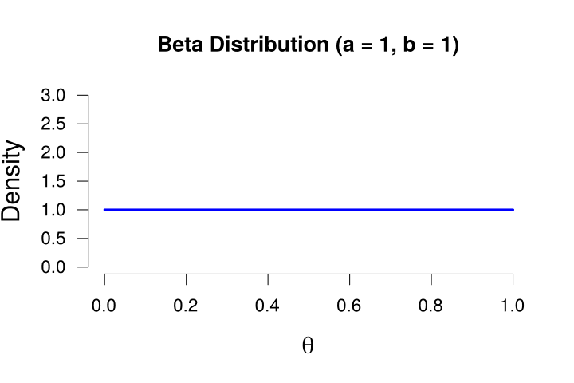
Models Can Also State a Range of Values
Introducing the beta distribution:
It ranges from 0 to 1
Its shape is determined by two values: a and b
If a and b equal 1, it is uniform
We use the beta distribution here because:
A proportion is also between 0 and 1
We can create many different shapes, which allows us to reflect many different prior ideas
We can reflect a model’s statement by means of a probability distribution

Slide 13
Models Can Also State a Range of Values
Introducing the beta distribution:
It ranges from 0 to 1
Its shape is determined by two values: a and b
If a and b equal 1, it is uniform
An applet that let you shape a beta distribution
https://maglit.me/bayesian-intro-shiny

Slide 14
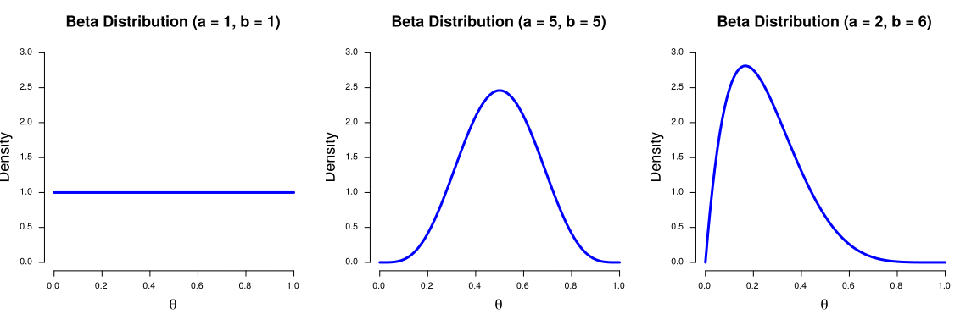
Models Can Also State a Range of Values
A model that reflects the idea that all values of the proportion are equally plausible - we call this an uninformative model
A model that reflects the idea that values close to 0.5 are more plausible
A prior distribution that reflects the idea that values below 0.5 are more plausible (i.e., the coin is biased towards tails)

Slide 15
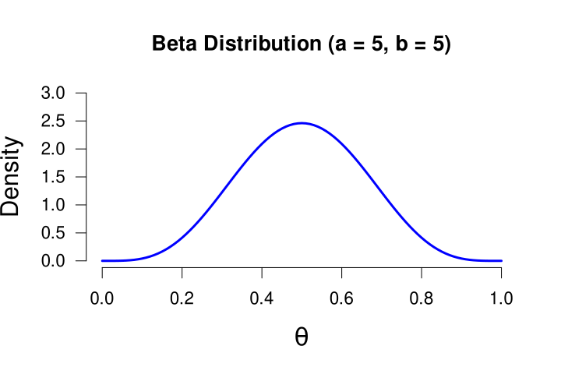

Beta Distribution Interpretation
Models that go all in on a single value have a very strong conviction: Sarah believes as if she has seen infinitely many heads and tails already!
In the context of a prior distribution for a proportion, the a and b can be interpreted as previously observed heads and tails.
We cannot start with an empty distribution (a and b cannot be 0), no matter how clueless you are about something, there will always be starting point (e.g., a = b = 1)

Slide 16
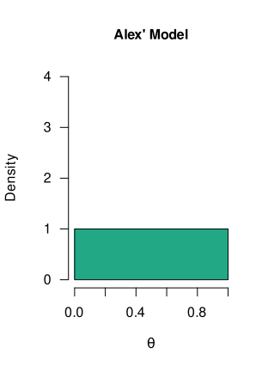
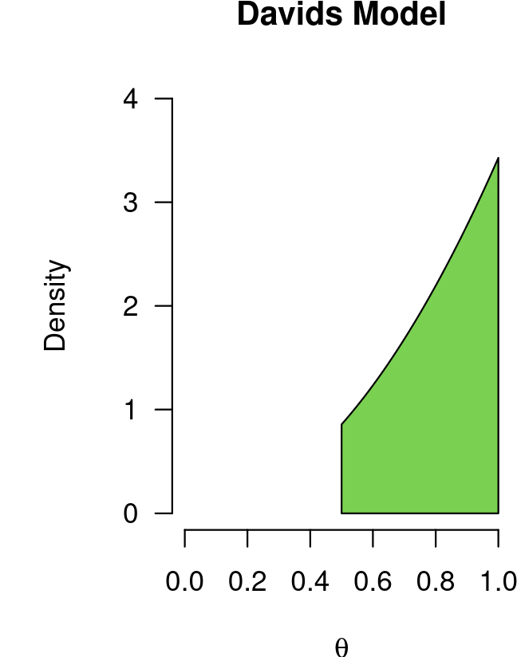
Models Can Also State a Range of Values
We can reflect a model’s statement by means of a probability distribution
A binomial model with θ ~ Beta(1, 1)
A binomial model with θ ~ Beta(3, 1)
It is truncated below 0.5, so Davids model only postulates values > 0.5
What are the theoretical implications of these models?

Slide 17
So, We Have All Sorts of Models...
Later we discuss comparing these models to each other
Now we focus on a single model, and how they learn from data

Slide 18
So, We Have All Sorts of Models...
These models reflect prior knowledge/beliefs
We will update this prior knowledge with data
To end up with posterior knowledge

Slide 19
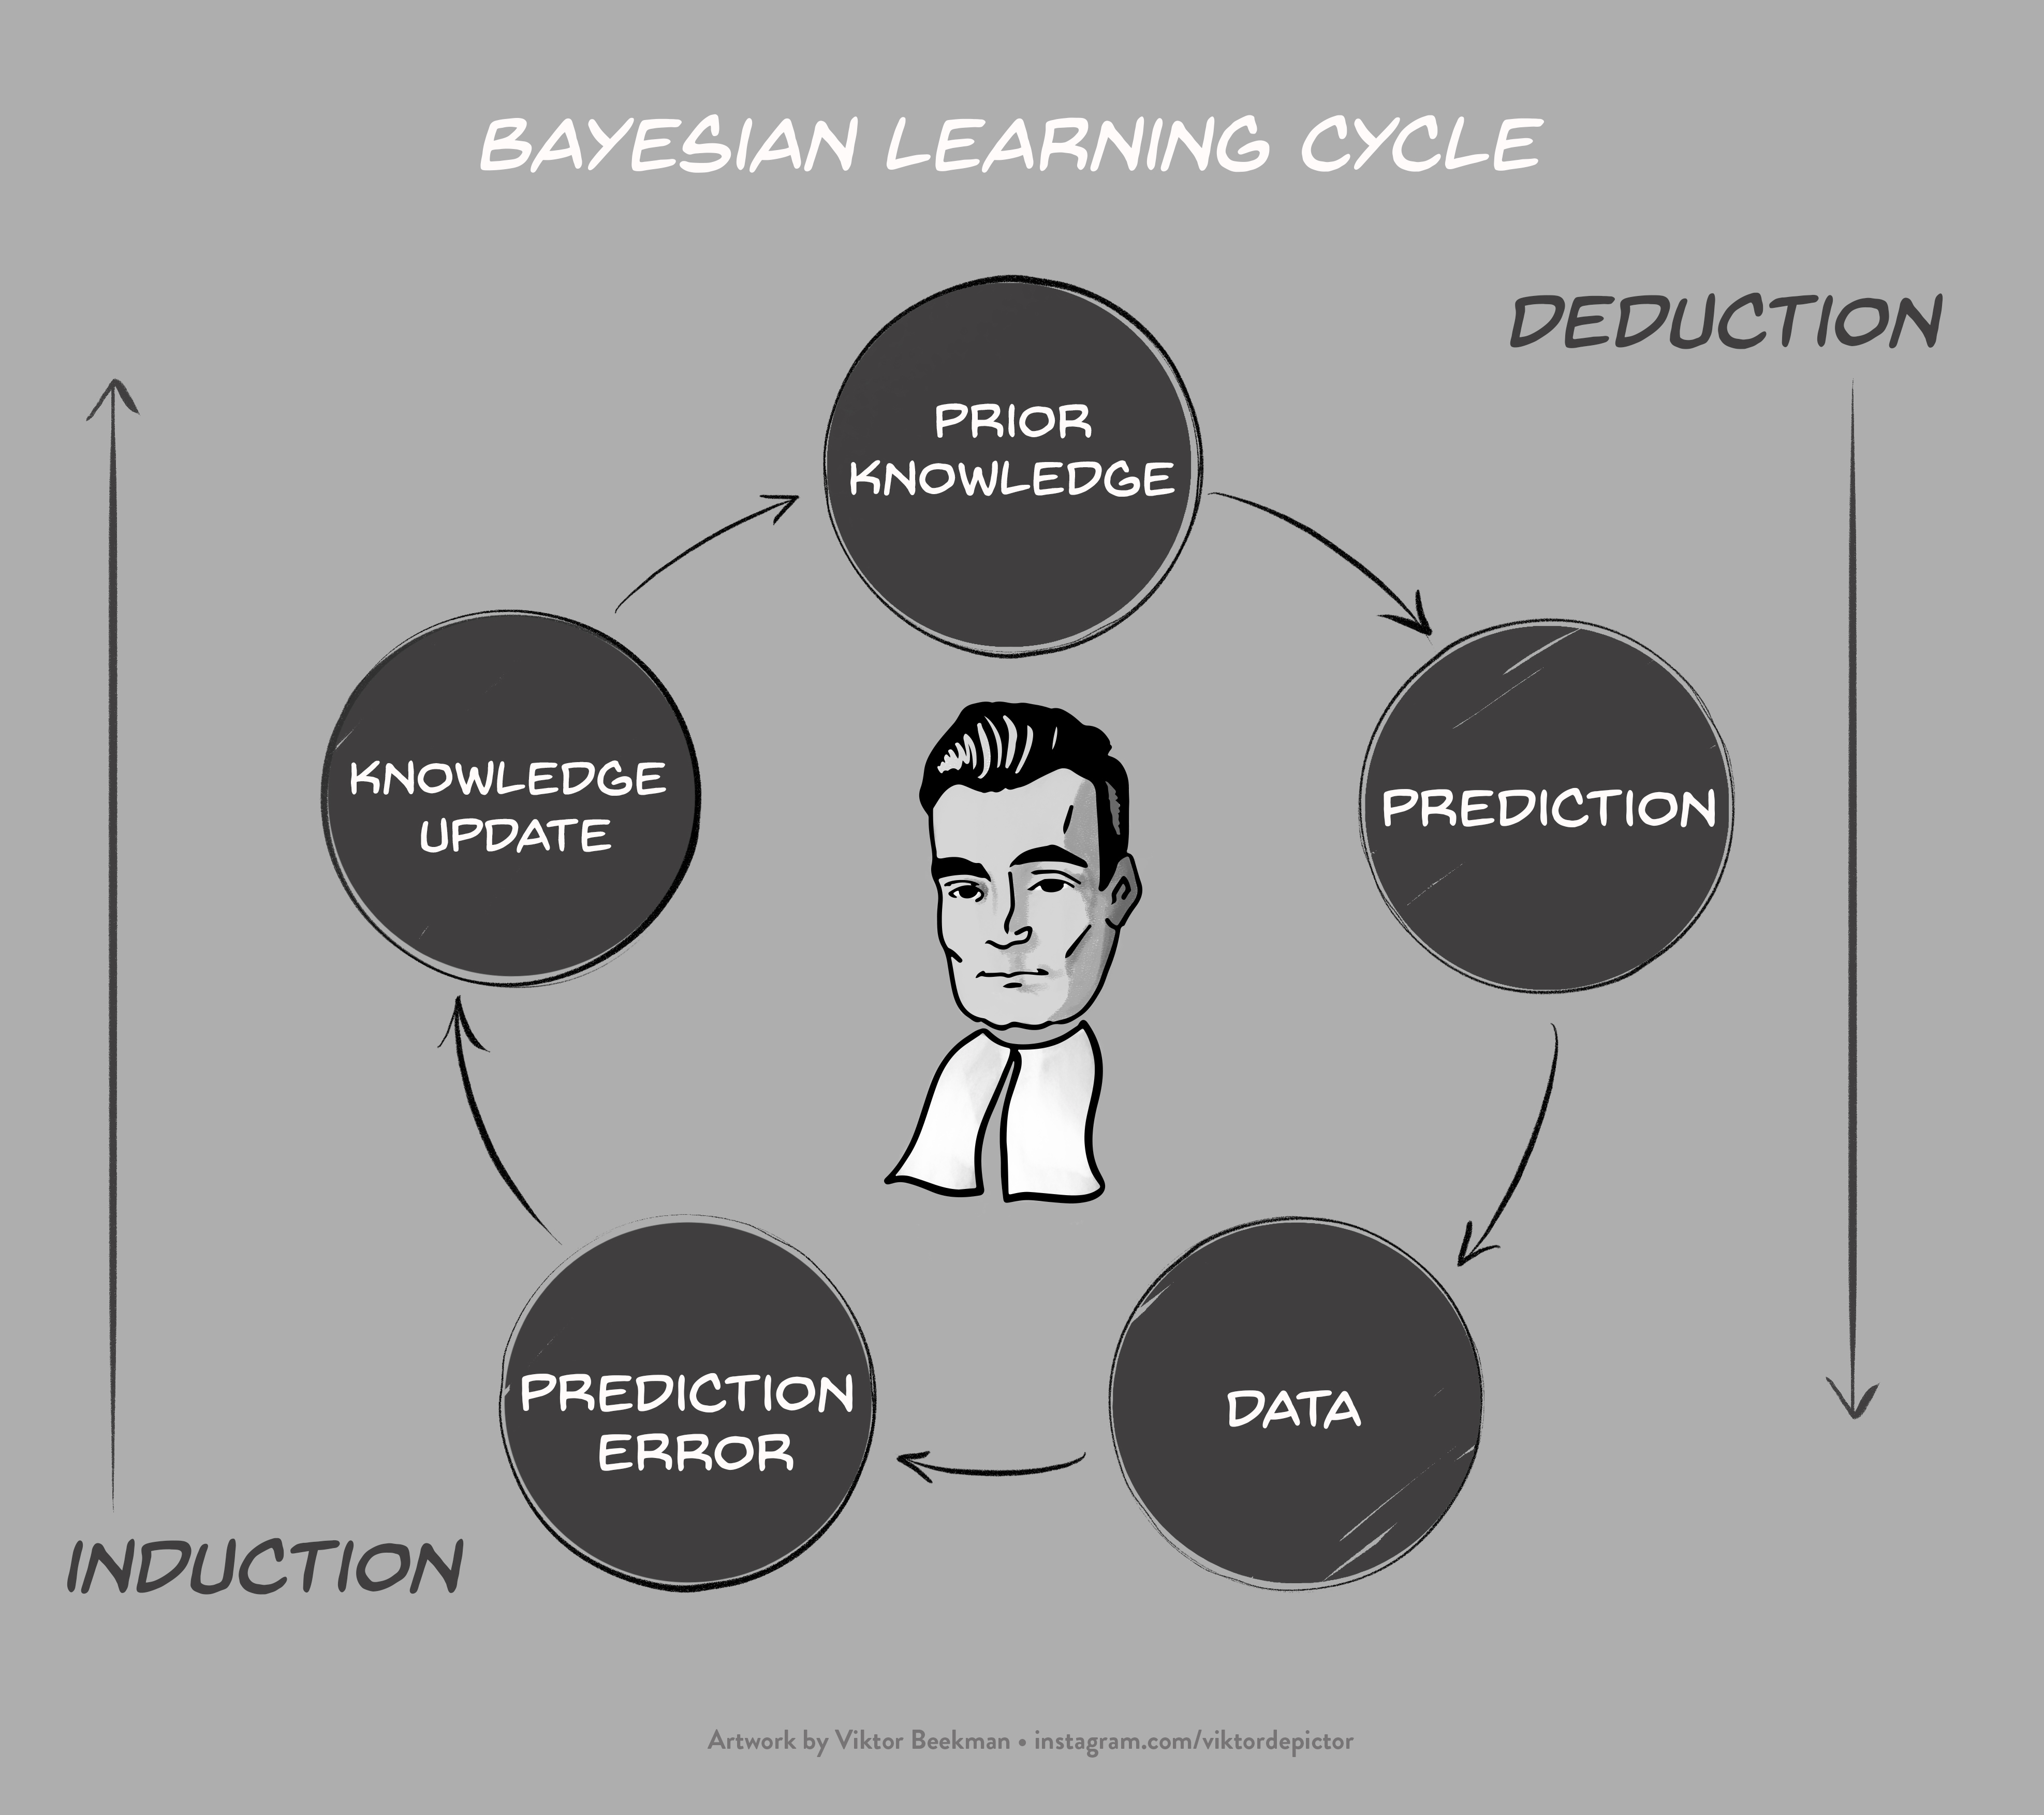
Source:
https://www.bayesianspectacles.org

Slide 20
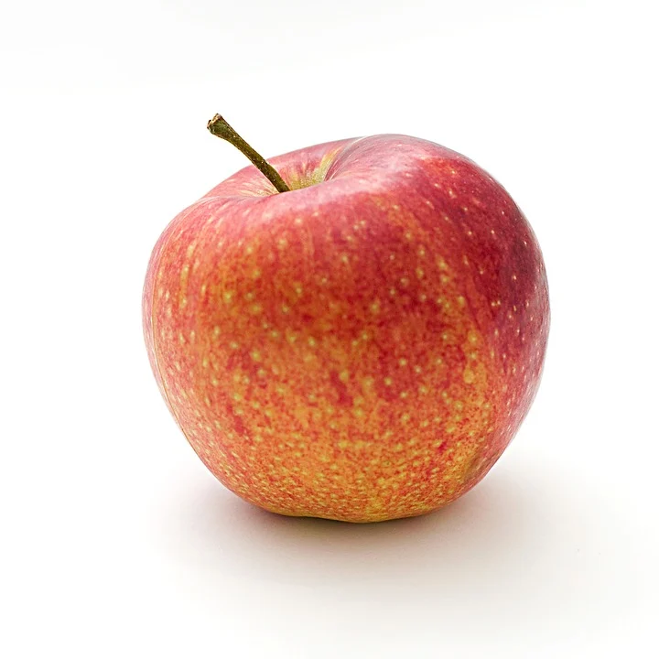

The Scenario for Today
vs
What is the proportion of Mac users in the population?

Slide 21
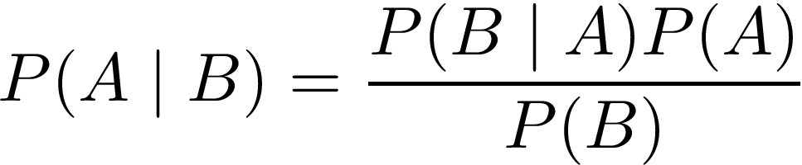
Bayes’ Theorem

Slide 22
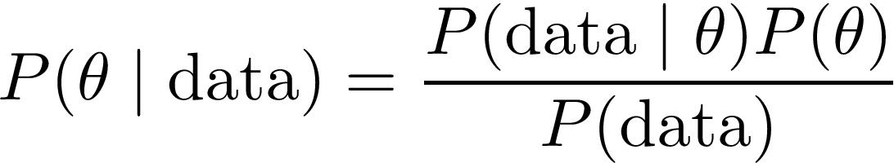
Applying Bayes’ Theorem to Statistical Inference
We can replace “A” and “B”, with parameter value “θ” and observed “data”

Slide 23
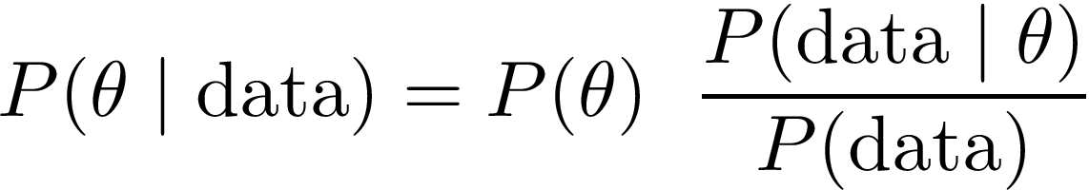
Applying Bayes’ Theorem to Statistical Inference
We can rewrite the theorem slightly:

Slide 24
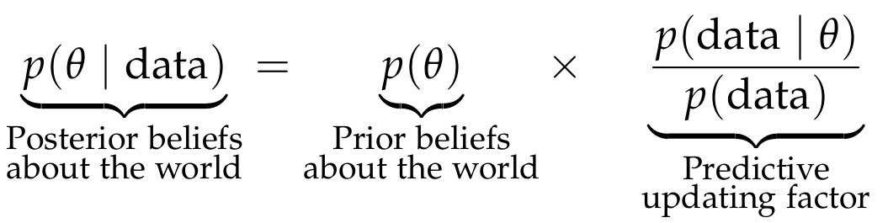
Bayesian Knowledge Updating
In the context of statistical analysis, the “world” refers to values of a parameter, such as the population proportion, or population correlation

Slide 25
Estimating a Proportion: Prior Distribution
The prior distribution reflects our beliefs about the parameter, before observing the data
In other words, one of the models we have seen so far!

Slide 26
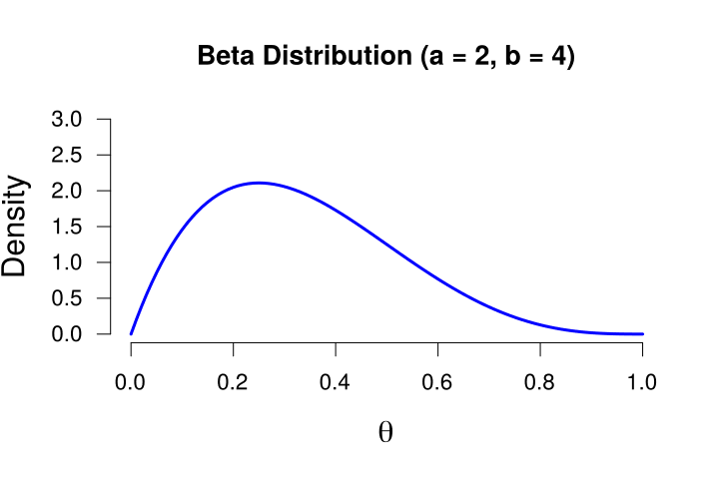
Estimating a Proportion: Prior Distribution
Let’s use the Beta prior distribution with a = 2, b = 4
(would you use a different prior?)

Slide 27
Bayesian Knowledge Updating
We update our prior knowledge by observing data

Slide 28
Estimating a Proportion: Some Frabricated Data
We observe the following data (n = 10):
3 Mac users
7 Windows users
Our statistic is the observed proportion: 3/10 = 0.3

Slide 29
Estimating a Proportion: Predictive Updating Factor
The likelihood of the data, given a certain value of θ in the model
The marginal likelihood, across all values of θ in the model
This tells us something about how well a specific value of θ predicted the data (i.e., it is the quality of the prediction for this specific value)
This tells us something how well θ predicted the data, averaged over all possible values of θ (i.e., it is the average quality of the prediction by this model)
Taken together, this ratio tells us how well each value of θ in the model predicted the data, relative to all other values!

Slide 30
Estimating a Proportion: Predictive Updating Factor
The likelihood of the data, given a certain value of θ in the model
For instance, how likely is our observed data, if θ equals 0.4?

Slide 31
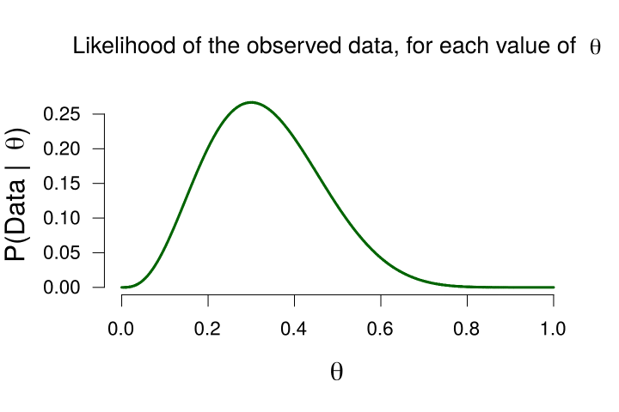
Estimating a Proportion: Predictive Updating Factor

Slide 32
Estimating a Proportion: Predictive Updating Factor

Slide 33
Estimating a Proportion: Predictive Updating Factor

Slide 34
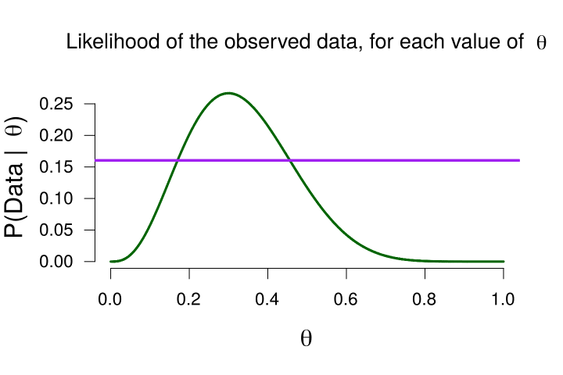
Estimating a Proportion: Predictive Updating Factor
The marginal likelihood, across all values of θ
This tells us something how well θ predicted the data, averaged over all possible values of θ (i.e., it is the average quality of the prediction by this model)
Usually this is very difficult and we need computers to compute this. In our case, the marginal likelihood equals 0.16

Slide 35
Estimating a Proportion: Predictive Updating Factor
The likelihood of the data, given a certain value of θ
The marginal likelihood, across all values of θ
Taken together, this ratio tells us how well each value of θ predicted the data, relative to all other values!
Now we know that the marginal (i.e., average) likelihood is 0.16. This means that when the likelihood of the data for a specific value of θ is greater than 0.16, that value of θ has predicted the data above average.
If that is the case, the predictive updating factor is > 1. If a specific value of θ predicted the data worse than average, that ratio is < 1.

Slide 36
Estimating a Proportion: Predictive Updating Factor
The marginal likelihood, across all values of θ (= 0.16)
This tells us something how well θ predicted the data, averaged over all possible values of θ (i.e., it is the average quality of the prediction by this model)

Slide 37
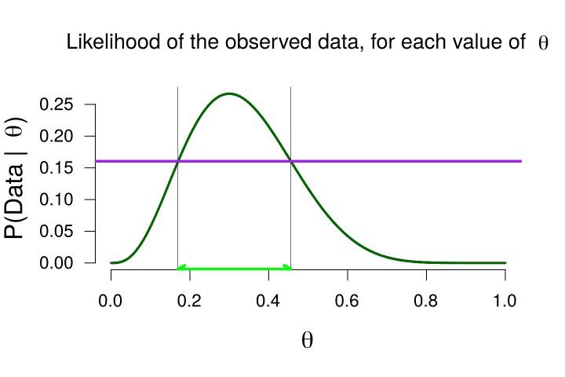
Estimating a Proportion: Predictive Updating Factor
The marginal likelihood, across all values of θ (= 0.16)
This tells us something how well θ predicted the data, averaged over all possible values of θ (i.e., it is the average quality of the prediction by this model)
Values of θ that predicted the data better than average (i.e., their likelihoods are greater than the marginal likelihood)

Slide 38
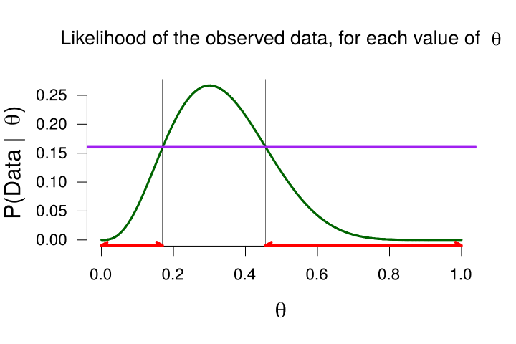
Estimating a Proportion: Predictive Updating Factor
The marginal likelihood, across all values of θ (= 0.16)
This tells us something how well θ predicted the data, averaged over all possible values of θ (i.e., it is the average quality of the prediction by this model)
Values of θ that predicted the data worse than average (i.e., their likelihoods are less than the marginal likelihood)

Slide 39
Estimating a Proportion: Some Notes on the Likelihood
The likelihood is the same for different prior distributions/models
However, the marginal likelihood is the average of the likelihoods, weighted by how the model divided its probability mass
The marginal likelihood is therefore different for different prior distributions
Since the marginal likelihood reflects the average quality of the predictions made by the model, we will use this later to perform model comparison

Slide 40
Bayesian Knowledge Updating

Slide 41
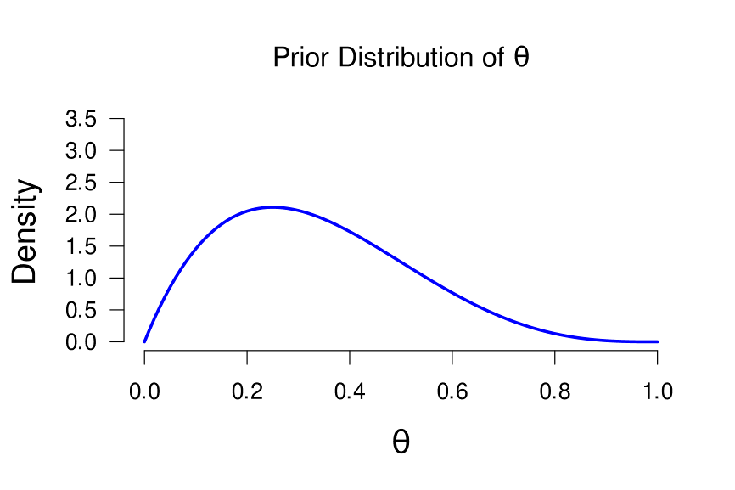
Estimating a Proportion: Posterior Distribution

Slide 42
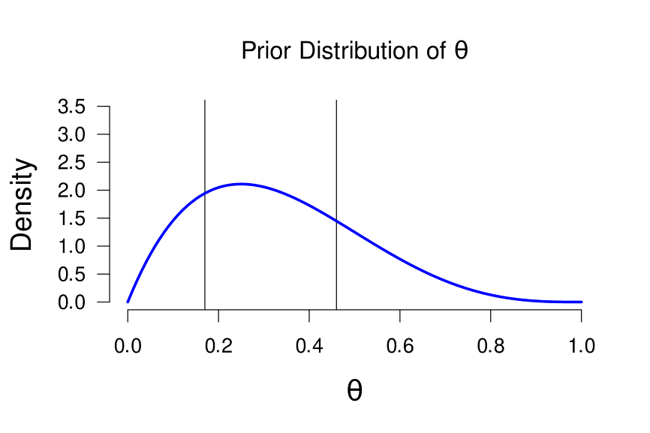
Estimating a Proportion: Posterior Distribution
Same lines as on slide 34/35! It shows which values of theta received a decrease/increase in plausibility, because of the data

Slide 43
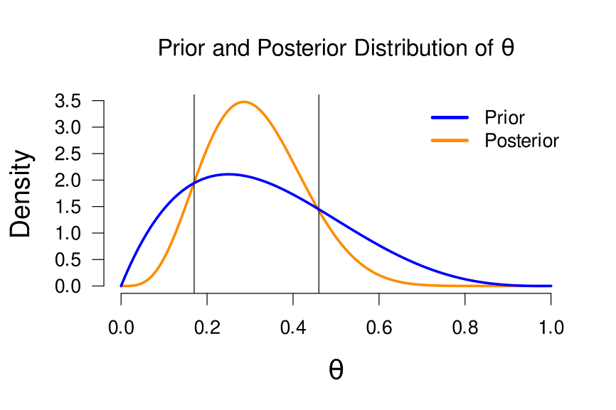
Estimating a Proportion: Posterior Distribution
Same lines as on slide 34/35! It shows which values of theta received a decrease/increase in plausibility, because of the data

Slide 44
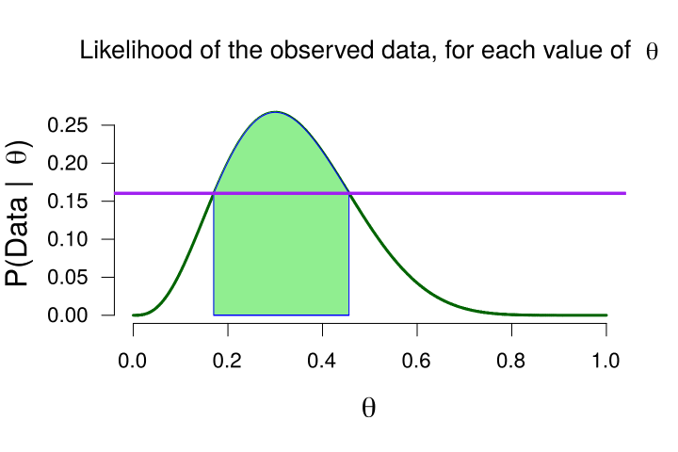
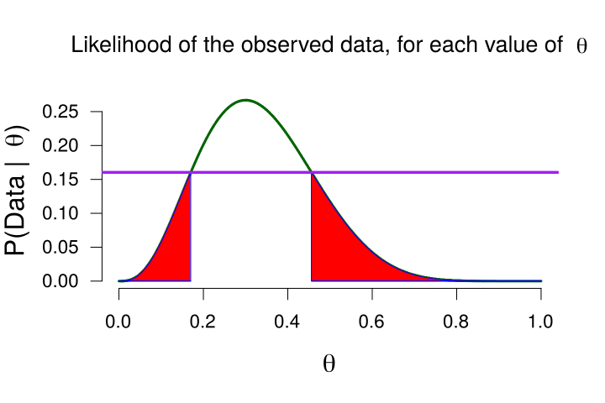
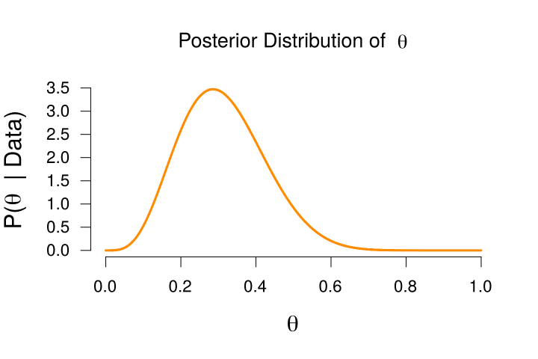
We start with our prior beliefs
We update those with data
Values of θ that predicted the data better than average receive a boost in plausibility (i.e., their updating ratio >1
Values of θ that predicted the data worse than average receive a penalty in plausibility (i.e., their updating ratio < 1
We end with our posterior beliefs

Slide 45
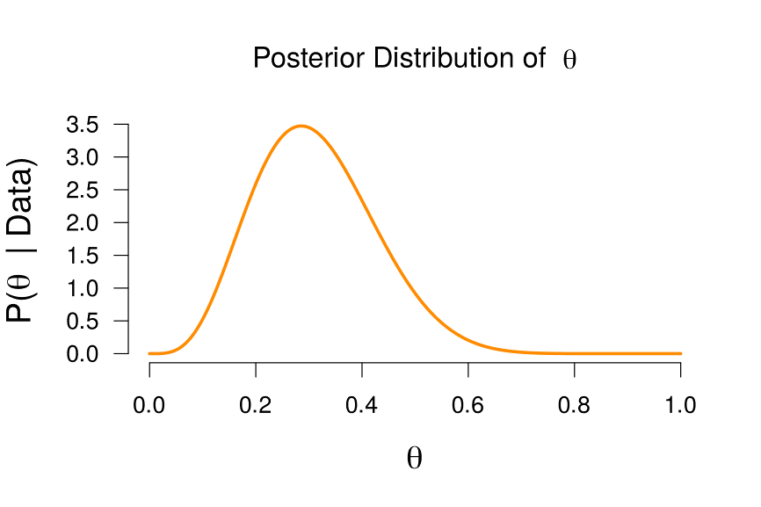
Estimating a Proportion: Posterior Distribution
We can look at the posterior distribution to do paramter estimation! This would be the best guess of this model

Slide 46
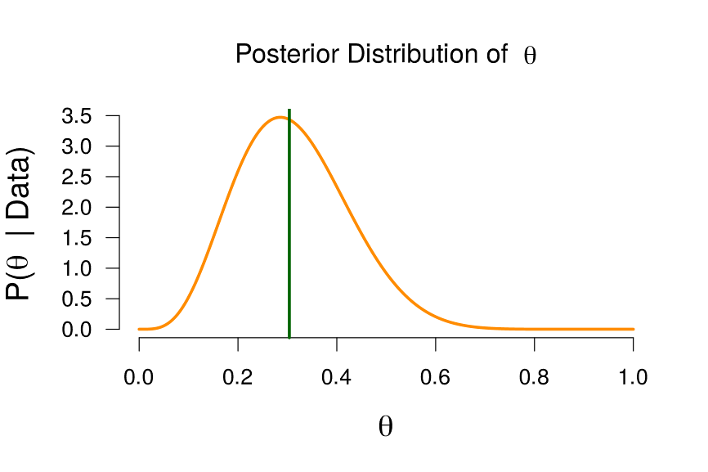
Estimating a Proportion: Posterior Distribution
We can look at the posterior distribution to do paramter estimation! This would be the best guess of this model
Median = 0.305
We can make a point estimate, and take the posterior median or mean

Slide 47
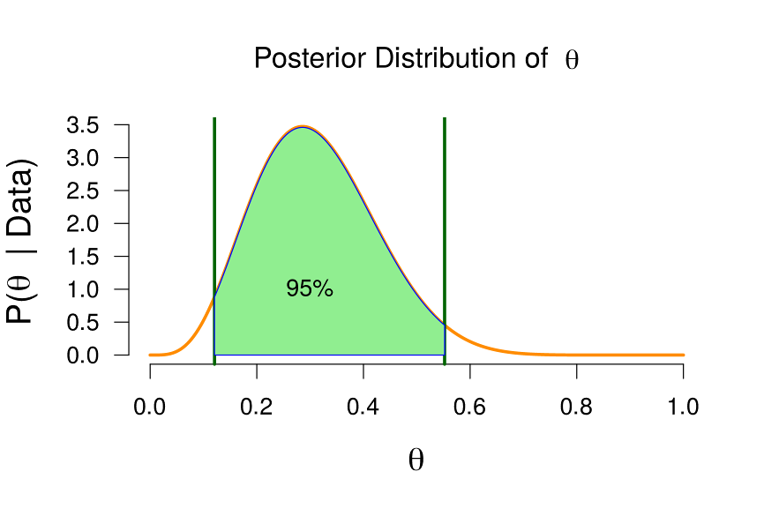
Estimating a Proportion: Posterior Distribution
We can make an interval estimate, and take the central Credible Interval
95% Credible interval = (0.12, 0.55)
To obtain the x% central credible interval, we take x% of the most central posterior mass, and see which 2 points are the thresholds
How to interpret a x% central credible interval?
Under this model, there is a x% probability that the true proportion is between 0.12 and 0.55

Slide 48
Live Demonstration
vs
https://maglit.me/bayesian-intro-shiny
JASP → Learn Bayes → Binomial Estimation

Slide 49
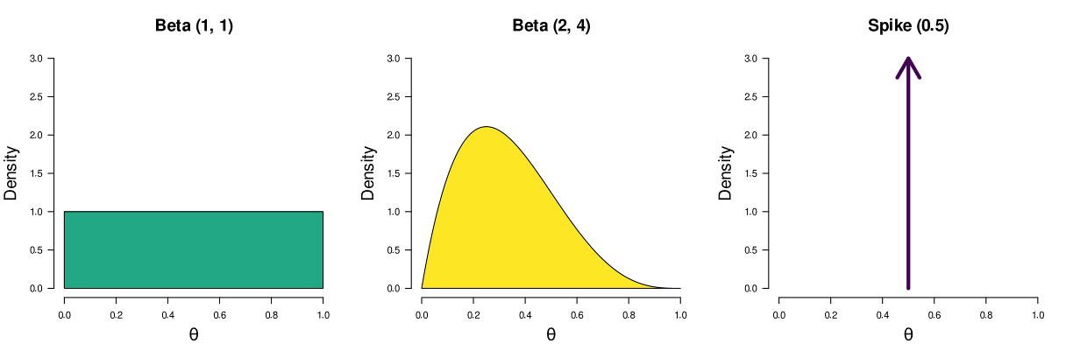
Testing a Proportion: Model Comparison
We have seen we can specify all sorts of models that reflect all sorts of statements about the population proportion

Slide 50
Testing a Proportion: Model Comparison
We have seen we can specify all sorts of models that reflect all sorts of statements about the population proportion

Slide 51
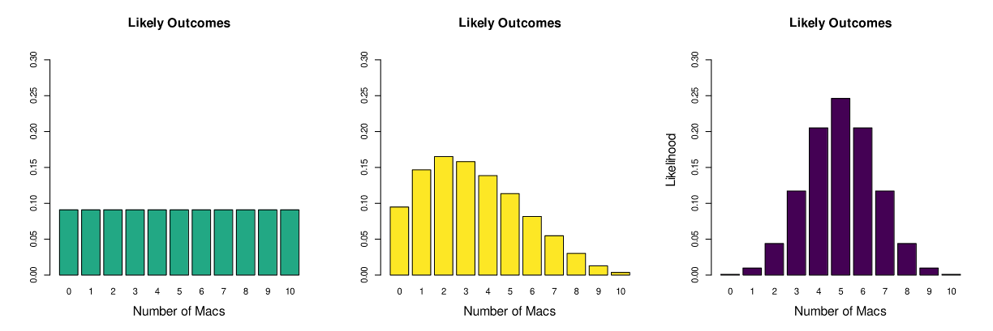
What Do the Models Predict?
“If you had 100€ to bet on likely values of θ, how would you divide it?”

Slide 52
How Well Did The Models Predict The Data?
The models placed their bets, we observed 3 Macs
How much the model bet on the observed outcome equals the quality of its prediction
The ratio of two such bars is known as the Bayes factor
“If you had 100€ to bet on likely values of θ, how would you divide it?”

Slide 53
Bayes Factor
The workhorse of Bayesian hypothesis testing
It quantifies which of two models predicted the data better, and how much better
Usually, we pit two models against each other:
The null model (H0), with a spike at the point of testing
(e.g., 0.5 for proportion, 0 for correlation or difference in means)
The alternative model (H1), which predicts multiple values (dictated by its prior distribution)
The alternative model can represent a one-sided or two-sided hypothesis

Slide 54
Bayes Factor Interpretation
Example 1: BF₁₀ = 20 The data are twenty times more likely under H₁ than under H₀
Example 2: BF₁₀ = 1/5 → BF₀₁ = 5 The data are five times more likely under H₀ than under H₁
Example 3: BF₁₀ = 1 The data are equally likely under H₁ and under H₀

Slide 55
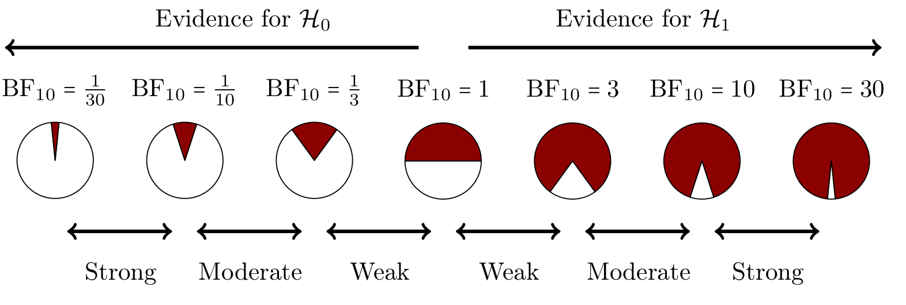
Bayes Factor Interpretation

Slide 56
Bayes Factor Interpretation

Slide 57
Bayes Factor Interpretation

Slide 58
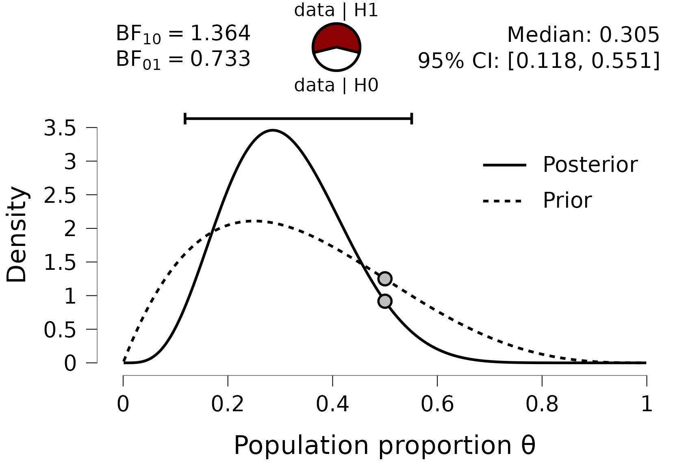
How Well Did The Models Predict The Data?
For comparing a point model to a range model, we can use the Savage-Dickey density ratio as a computational shortcut to obtain the Bayes Factor
BF10 = prior density at point of testing / posterior density at point of testing

Slide 59
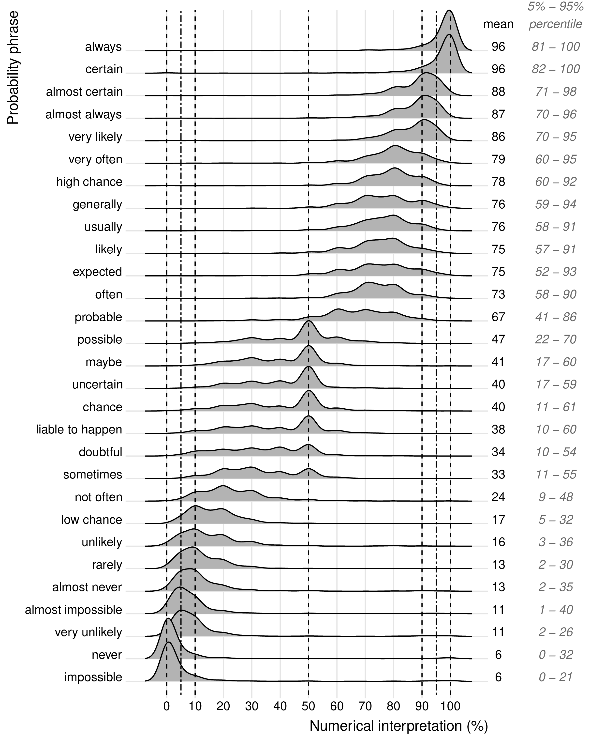
Bayes Factor Interpretation - Caution
But!
The general challenge of translating between words and numbers:
People have different interpretations of probabilistic words/phrases
Source: Willems, S., Albers, C., & Smeets, I. (2020). Variability in the interpretation of probability phrases used in Dutch news articles — a risk for miscommunication. Journal of Science Communication, 19.

Slide 60

Bayes Factor Interpretation - Caution

Slide 61

Bayes Factor Interpretation - Caution
RELATIVE!

Slide 62

Bayes Factor Interpretation - Caution
RELATIVE!

Slide 63
Bayes Factor Features
Parsimony
A built in Occam’s Razor (e.g., one-sided vs two-sided)
Sensitivity Analysis
Investigate the impact of the prior distribution
Sequential Analysis
Monitor evidence as data accumulate

Slide 64
Bayes & Frequentism
Bayes | Frequentism
Compare the predictive quality of two hypotheses → Invites continuous reasoning | Minimize type 1 error (incorrectly reject H₀) → Invites binary reasoning
Can monitor the results as data accumulate | Can only look at the data once: looking twice increases the risk of type 1 error
Check assumptions | Check assumptions
Still incomplete (but steadily expanding) | Has wide range of types of analyses
Sampling plan: can monitor the results and stop when satisfied | Have to specify sampling plan before, based on hypothesized effect size

Slide 65
Live Demonstration
vs

Slide 66
Try It Yourself!
Try your new-found knowledge on your own data, or try some of the example exercises
https://johnnydoorn.github.io/IntroductionBayesianInference/exercises.html
Bayesian T-test/ANOVA?

Slide 67
Choosing the Prior Distribution
Before the experiment / looking at the data (so there are no calculations)
Informed by previous experiments/knowledge or kept uninformative (e.g., uniform prior on the population proportion)
One-sided / two-sided determined by what you want to test (e.g., do you want to know if there is a difference, or a positive difference?)
Assess robustness of result to choice of prior distribution

Slide 68
Choosing the Prior Distribution
The prior distribution is on the same domain as the parameter of interest:
For a proportion: [0, 1]
For a correlation: [-1, 1]
For a difference in means: [-∞, ∞]

Slide 69
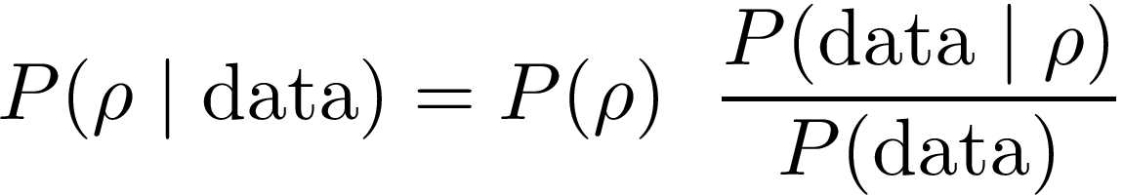
Bayesian Correlation

Slide 70
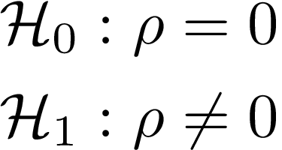
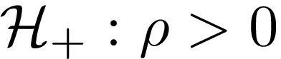
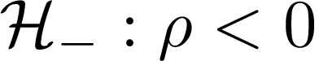
Bayesian Correlation: Hypothesis
“Alternative Hypothesis”

Slide 71
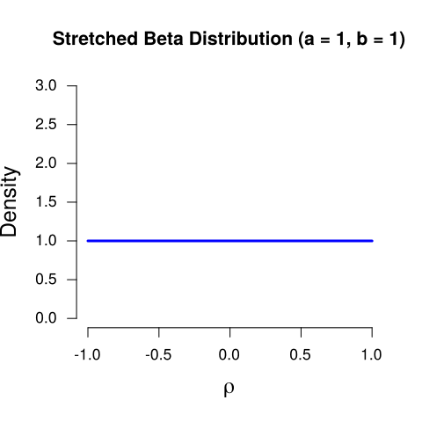
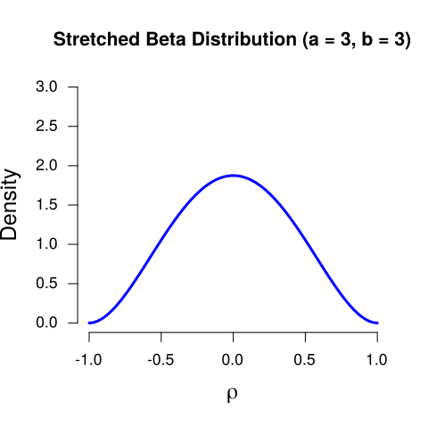
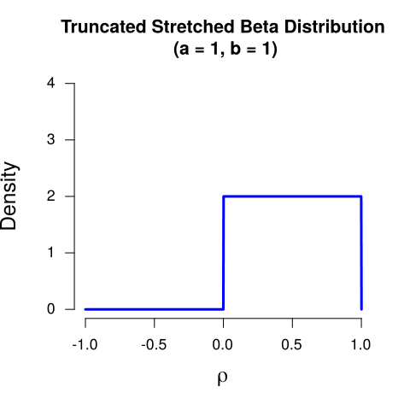
Bayesian Correlation: Prior Distribution
The prior distribution is on the same domain as the parameter of interest: we can take the stretched Beta distribution!
It is the same as Beta, but then stretched to the domain [-1, 1]

Slide 72
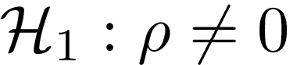
Bayesian Correlation: Prior Distribution
A prior distribution that reflects the belief that all values of ρ are equally plausible, a priori, we call this an uninformative prior
A prior distribution that reflects the belief that values of ρ close to 0 are more plausible (i.e., the correlation will be around 0 or not be very strong), a priori
A prior distribution that reflects the belief that only positive values of ρ are possible and that those values of ρ are equally plausible (i.e., there will be a positive correlation), a priori

Slide 73
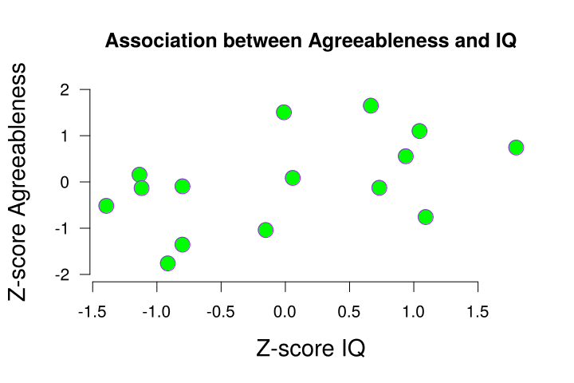
Bayesian Correlation: Data

Slide 74
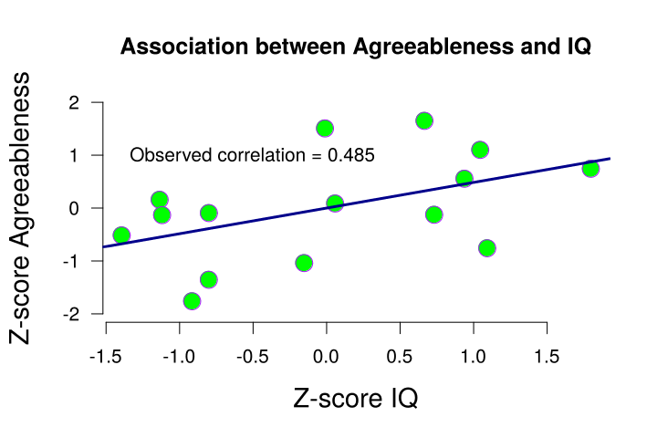
Bayesian Correlation: Data

Slide 75
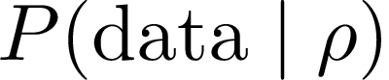
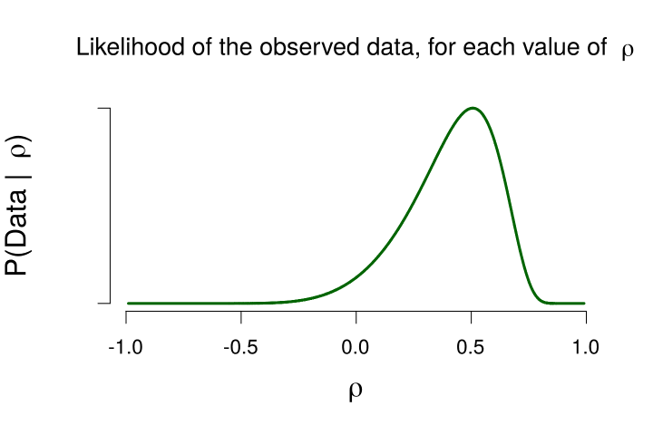
Bayesian Correlation: Likelihood
We see that the data are likely for values of ρ close to 0.5.
This makes sense, because the observed correlation (i.e., the data) is equal to 0.485!

Slide 76
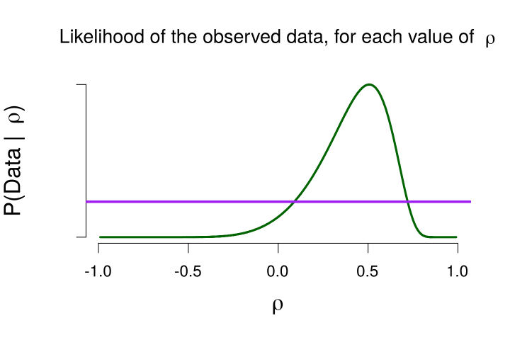
Bayesian Correlation: Likelihood
The marginal likelihood, across all values of ρ

Slide 77
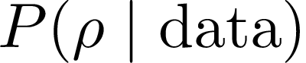
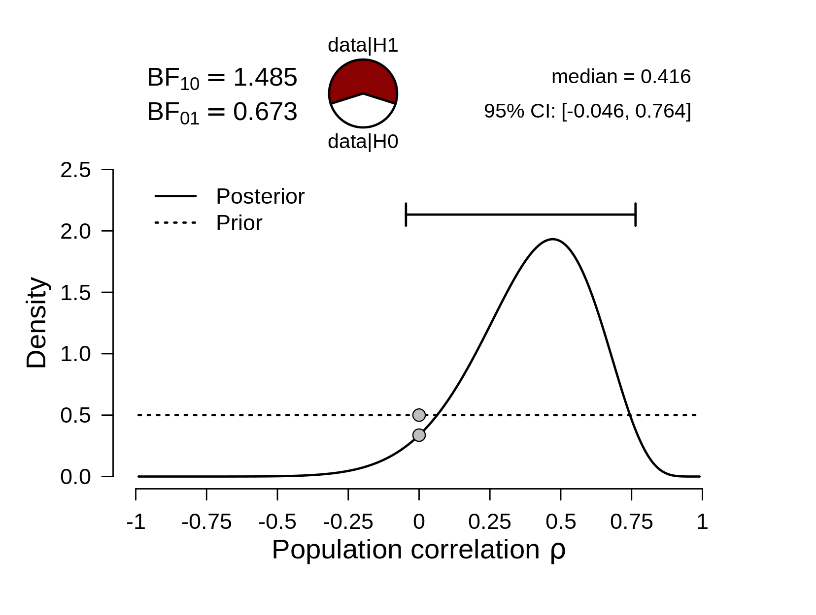
Bayesian Correlation: Posterior Distribution

Slide 78
Bayesian Correlation: Posterior Distribution
Median:
50% probability that ρ is equal to or lower than 0.416, under this model
95% Credible interval:
95% probability that ρ is between -0.046 and 0.764, under this model

Slide 79
Bayesian Correlation: Bayes Factor
Very weak evidence in favor of either hypothesis, and a very wide credible interval… What if instead of n = 15, we had n = 40, but the same observed correlation (+- 0.5)?

Slide 80

Bayesian Correlation: Data

Slide 81

Bayesian Correlation: Likelihood
The likelihood grew more narrow, compared to when we had a lower sample size!

Slide 82

Bayesian Correlation: Posterior Distribution
95% Credible interval:
“95% probability that ρ is between 0.193 and 0.679”
The posterior is also more narrow!
This also leads to a more narrow credible interval (still 95%, but the two numbers are closer together (e.g., 0 is no longer in the interval)
We can make a more specific prediction, with the same certainty (95%)

Slide 83
Bayesian Correlation: Bayes Factor
Now we have pretty strong evidence that there is an association between the variables (BF₁₀ = 25)

Slide 84
Bayesian Correlation: Bayes Factor
N = 15, observed correlation = 0.485
N = 40, observed correlation = 0.5

Slide 85


“Absence of evidence” vs “evidence of absence”
Both analyses would yield a non-significant p-value – but what does that actually mean?

Slide 86

Bayesian T-Test
What about differences between/within groups?
In psychology, differences between groups are characterized by δ (“delta”, also known as Cohen’s d): a standardized difference between groups
As with the Bayes factor, this is a table to provide some intuition for the magnitude of an effect – there are no hard cut-off values here!
For further reading and formulas https://en.wikipedia.org/wiki/Effect_size#Difference_family:_Effect_sizes_based_on_differences_between_means

Slide 87

Bayesian T-Test

Slide 88




Bayesian T-Test: Hypothesis
“Alternative Hypothesis”

Slide 89



Bayesian T-Test: Prior Distribution
The prior distribution is on the same domain as the parameter of interest: so we need a distribution that is between [-∞, ∞].
A normal distribution could work, but the convention is to use a t-distribution with df = 1. This is known as the Cauchy distribution
A uniform distribution would not work here, because delta has an infinite domain
The Cauchy distribution is governed by a single shape parameter that determines how wide it is

Slide 90
Bayesian T-Test: Prior Distribution
A prior distribution that reflects the belief that 50% of the values of δ are located between -0.707 and 0.707, a priori
A prior distribution that reflects the belief that 50% of the values of δ are located between -1.5 and 1.5 , a priori
A prior distribution that reflects the belief that only positive values of δ are possible and that 50% of the values of δ are between 0 and 0.707, a priori
This is often selected as the uninformative option. Why? Unfortunately that is a long and technical story, not suited for this workshop :(

Slide 91

Bayesian T-Test: Data
Observed δ = 0.95
(t = 3.27)
n = 25

Slide 92


Bayesian T-Test: Likelihood
We see that the data are likely for values of δ close to 1.
This makes sense, because the observed delta (i.e., the data) is equal to 0.95!

Slide 93
Bayesian T-Test: Likelihood
The marginal likelihood, across all values of δ

Slide 94


Bayesian T-Test: Posterior Distribution

Slide 95
Bayesian T-Test: Bayes Factor

Slide 96

Bayesian T-Test: Robustness Check
Because choosing the prior setting is fairly subjective, we can explore what would have happened if we had chosen a different value for the prior width. This is known as a Bayes factor robustness check, or sensitivity analysis
We see here that the Bayes factor is pretty stable (i.e., flat line) across many values for the prior width. Except for very strong prior settings (0.15 and lower) does the evidence for H₁ decrease
“Here, the Bayes factor does not qualitatively differ for a wide range of prior specifications (0.25 – 1.5)

Slide 97
Bayesian ANOVA
Singer Heights
This data set, "Singers", provided "Heights in inches of the singers in the New York Choral Society in 1979. The data are grouped according to voice part.
Variables:
Height - Height (in inches) of the singers.
Gender - Gender of the singers (female, male).
Pitch - Voice pitch of the singers (very low, low, high, very high)
Research question: to what extent does height differ for different vocal pitches and gender?
Source:
Chambers, J. M., Cleveland, W. S., Kleiner, B., & Tukey, P. A. (1983). Graphical Methods for Data Analysis. New York: Chapman & Hall.

Slide 98
Singer Height
MODEL
S_{i} = α + β₁W_{i} + β₂ P_{i} + ε_{i}
Height = base level + pitch + gender + error
S_{i} = α + β₁W_{i} + ε_{i}
Height = base level + pitch + error
S_{i} = α + β₂ P_{i} + ε_{i}
Height = base level + gender + error

Slide 99

Singer Height

Slide 100

Singer Height

Slide 101
Many Models? Again?
In ANOVA (and regression) we compare models
Differs from classical analysis, where we assess effects
Each model instantiates a theoretically interesting assumption
All tests of interest are pairwise
Remember: "Best" model is:
Not necessarily good (check assumptions)
Not necessarily much better than second best

Slide 102
Handy Literature
van Doorn, J., van den Bergh, D., … & Wagenmakers, E.-J. (2021). The JASP guidelines for conducting and reporting a Bayesian analysis. Psychonomic Bulletin & Review, 28, 813-826.
Etz, A., & Vandekerckhove, J. (2018). Introduction to Bayesian inference for psychology. Psychonomic bulletin & review, 25(1), 5-34.
Wagenmakers, E.-J.,… & Morey, R. D. (2018). Bayesian inference for psychology. Part II: Example applications with JASP. Psychonomic Bulletin & Review, 25, 58-76.
van den Bergh, D., Van Doorn, J., Marsman, M., Draws, T., Van Kesteren, E. J., Derks, K., ... & Wagenmakers, E. J. (2020). A tutorial on conducting and interpreting a Bayesian ANOVA in JASP. LAnnee psychologique, 120, 73-96.
Field, A., van Doorn, J., & Wagenmakers, E.-J. (in press). Discovering statistics using JASP. London: Sage.

Slide 103
Handy Resources
The JASP Video Library
The JASP Data Library
Discovering Statistics Using JASP
How to Use JASP – Inventory of blogs/videos/gifs for frequentist and Bayesian analyses
JASP YouTube page
Step By Step Guide: 1. Bayesian One-Way ANOVA and the full playlist
JASP on Bluesky - https://bsky.app/profile/jaspstats.bsky.social
JASP forum - https://forum.cogsci.nl/index.php?p=/categories/jasp-bayesfactor
Found a bug? Please report on Github: https://github.com/jasp-stats/jasp-issues/issues
JASP Verification Project
More JASP workshops: https://jasp-stats.org/workshop/

Slide 104

The Future of JASP
Feature roadmap
Full syntax mode
More data manipulation
Selective filtering
Module library
JASP Community

